Slide 1
SexySinglesOnYourWifi
An mobile social engagement platform

Slide 2
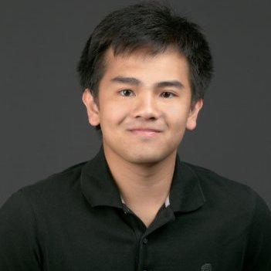

Meet the Team
Ty Trusty
Ty is a junior studying computer science at UT Austin. He got the least amount of sleep on our team and enjoys baking in his free time.
Tin La
Tin is a junior studying computer science at UT Austin. He like to play tennis and is waiting for bitcoin to go down to purchase a new graphics card.
Claire Dubiel
Claire is a junior studying computer science at the University of Texas at Austin. She is interested in the intersection between big data computing and genetics.
Xan Becker
Is a junior studying computer science at the University of Texas at Dallas. He has a pet Bichon Poodle mix dog.
= caffeine consumption during the hackathon

Slide 3
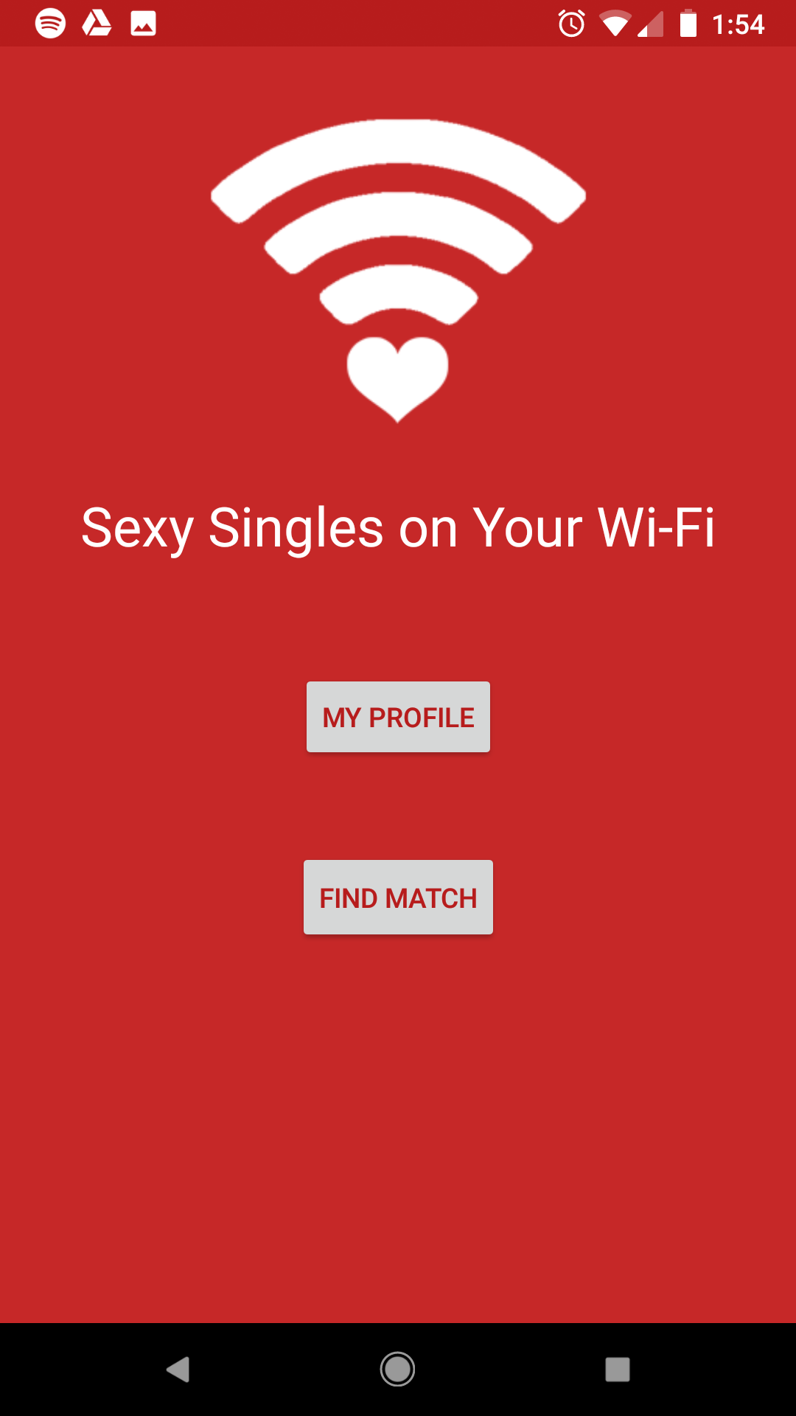
You Got A Match!
❤ Follow your Hotspot ❤
Place your screenshot here

Slide 4
Inspiration
Humans are creatures of habit
Meet people in environments you are familiar with
You may find that you share more than just a wifi network

Slide 5
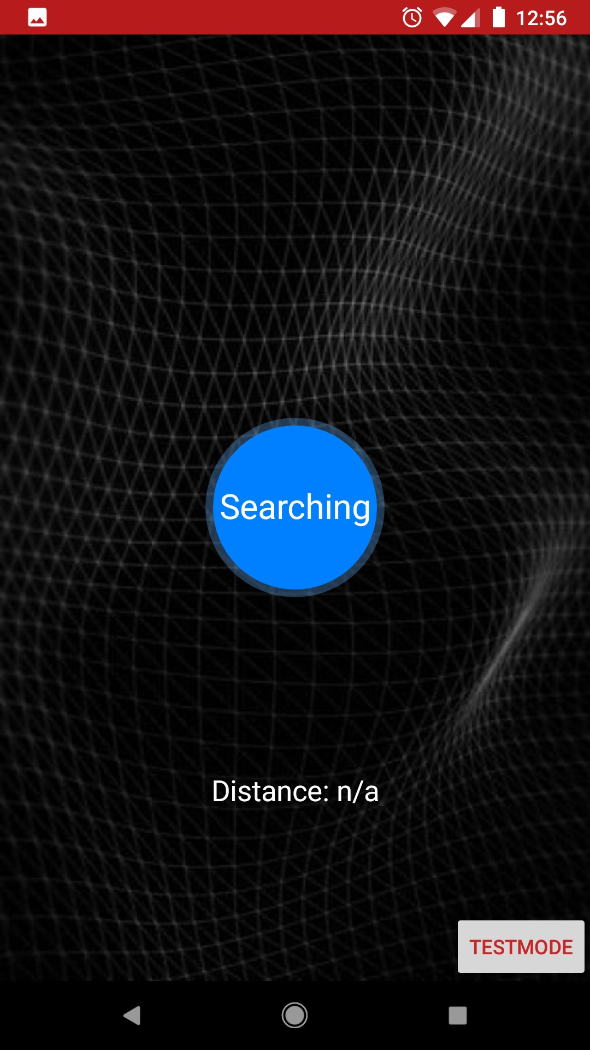
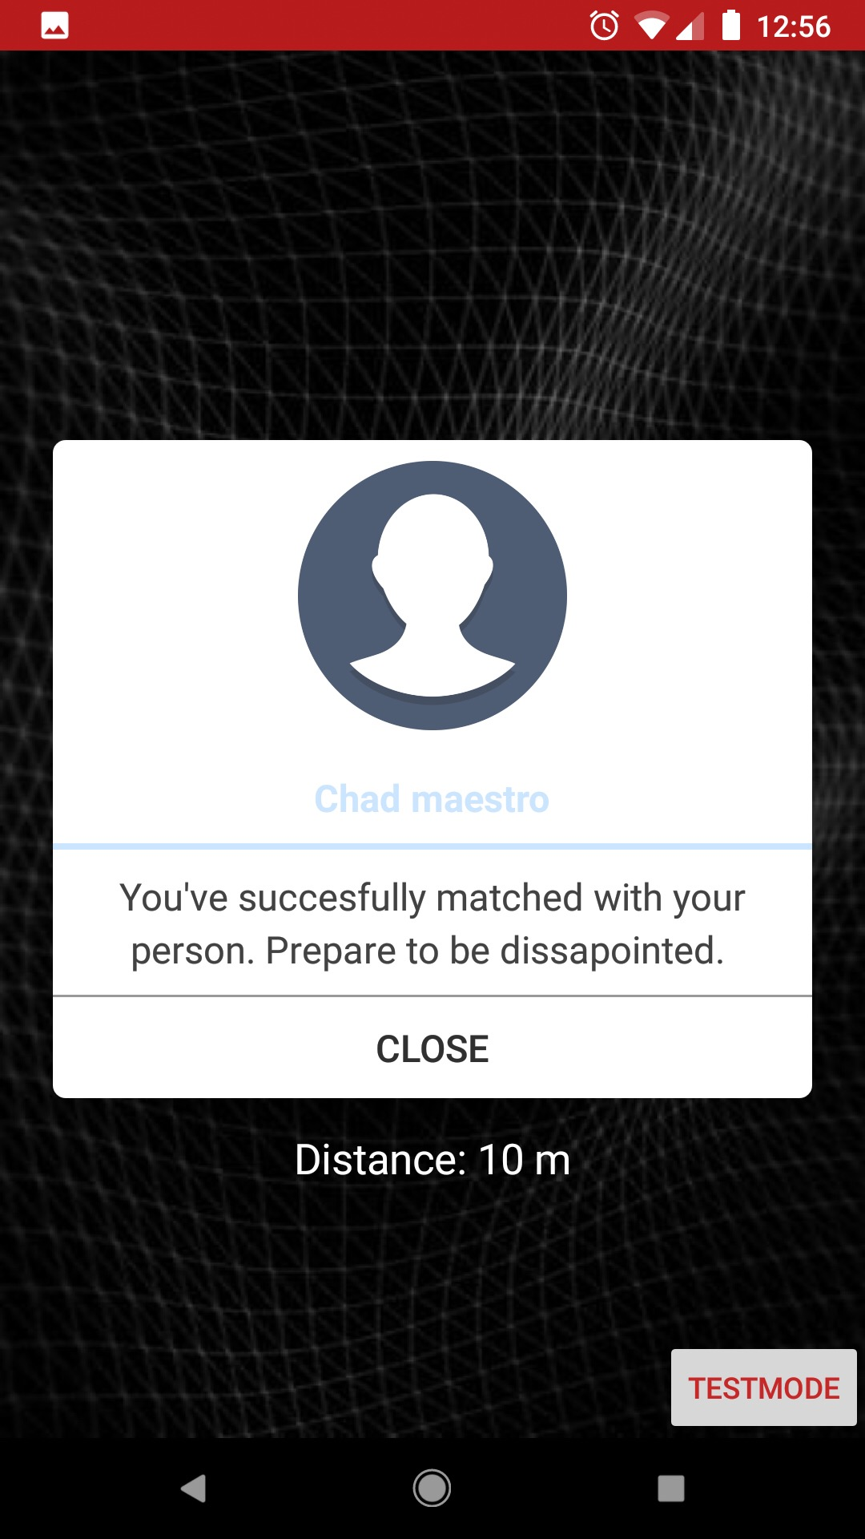
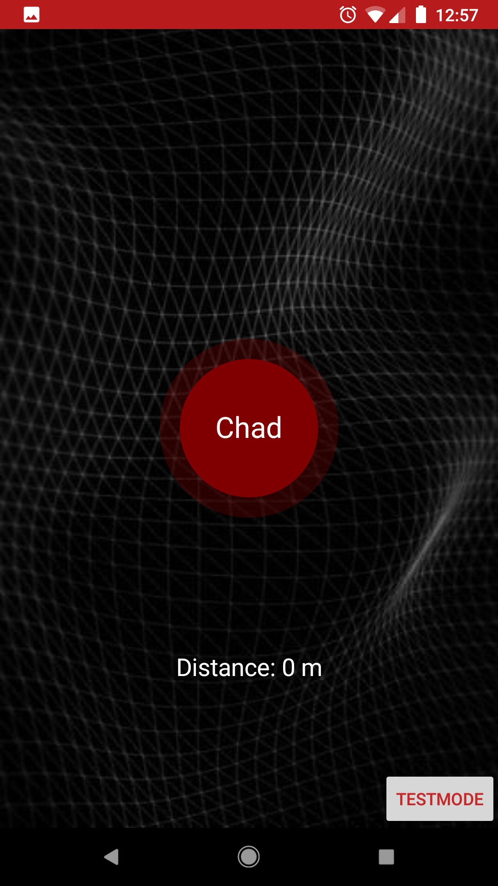
What It Does

Slide 6



How We Built It
Python Flask
Android Studio
AWS

Slide 7

Demo Time!

